Slide 1

Learnings of 2st two week Md. Iabur Rahman

Slide 2
Hello!
I am Md. Iabur Rahman
Now I am going to present a few topics of internship program from day eleven to day twenty at iXora Solution LTD.

Slide 3
Relational Database
Data represented in the form of tables.
Examples: Oracle, SQL server, db2, Teradata, Sybase, MySQL, PostgreSQL.

Slide 4
Advantages of Relational Database
Avoids data duplication.
Avoids inconsistent records.
Easier to change data.
Easier to change data format.
Data can be added and removed easily.
Easier to maintain security.
Pre-Defined Rules.

Slide 5
Disadvantages of Relational Database
Physical Storage Consumption.
Slow extraction of meaning from data.
Developer Budget Expertise.

Slide 6
Non-Relational Database
Data represented in the form of trees, graphs structured format except table.
Examples: Mongodb, Casandra, Hive, Hbase, Mariadb.

Slide 7
Advantages of Non-Relational Database
No Fixed Schema.
Ability to handle big data better.
Lesser server cost.

Slide 8
Disadvantages of Non-Relational Database
No rules and restrictions.
Data inconsistency.
Replication of large databases may fail.
No any standard language.

Slide 9
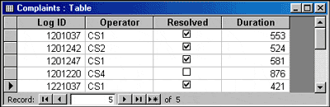
Tables
A database table is composed of records and fields that hold data. Tables are also called datasheets. Each table in a database holds data about a different, but related, subject.

Slide 10
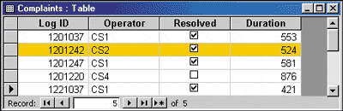
Records
Data is stored in records. A record is composed of fields and contains all the data about one particular person, company, or item in a database. A record for Log ID 1201242 is highlighted in Figure.

Slide 11
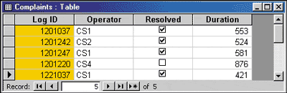
Fields
A field is part of a record and contains a single piece of data for the subject of the record. In the database table illustrated in Figure 4, each record contains four fields.

Slide 12
SQL CREATE DATABASE Statement
Syntax: CREATE DATABASE databasename;
Example: CREATE DATABASE testDB;

Slide 13
SQL DROP DATABASE Statement
Syntax: DROP DATABASE databasename;
Example: DROP DATABASE testDB;

Slide 14
USE Statement
When using multiple databases in SQL Schema, then before starting operation, would need to select a database where all the operations would be performed.
Syntax: USE DatabaseName;

Slide 15
SQL SELECT DISTINCT Statement
Syntax: SELECT DISTINCT column1, column2, ... FROM table_name;
Example: SELECT DISTINCT Country FROM Customers;

Slide 16
SQL Aliases
SQL aliases are used to give a table, or a column in a table, a temporary name.
Alias Column Syntax: SELECT column_name AS alias_name FROM table_name;
Alias Table Syntax: SELECT column_name(s) FROM table_name AS alias_name;

Slide 17
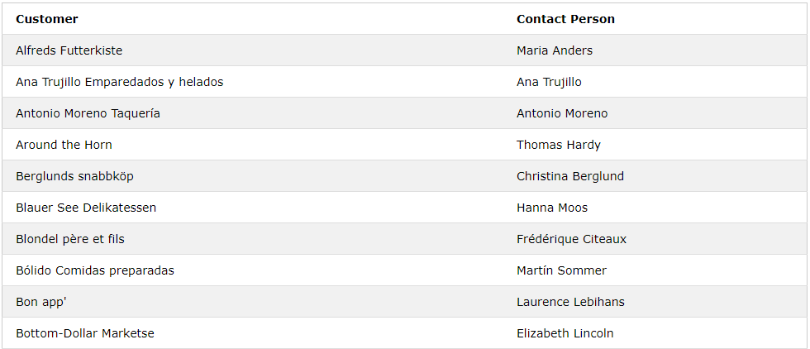
Alias for Columns Examples
SELECT CustomerName AS Customer, ContactName AS [Contact Person] FROM Customers;

Slide 18
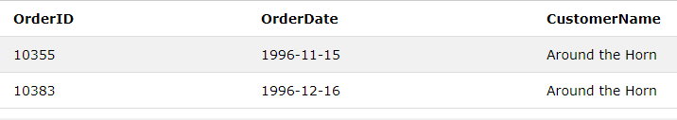
Alias for Tables Example
SELECT o.OrderID, o.OrderDate, c.CustomerName
FROM Customers AS c, Orders AS o WHERE c.CustomerName="Around the Horn" AND c.CustomerID=o.CustomerID;

Slide 19
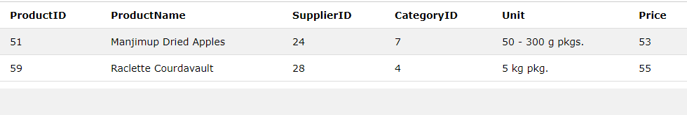
Between a certain range
Example: SELECT * FROM Products WHERE Price BETWEEN 50 AND 60;

Slide 20
SQL LIKE Operator
The LIKE operator is used in a WHERE clause to search for a specified pattern in a column.
% - The percent sign represents zero, one, or multiple characters
_ - The underscore represents a single character
LIKE Syntax: SELECT column1, column2, ... FROM table_name WHERE columnN LIKE pattern;

Slide 21
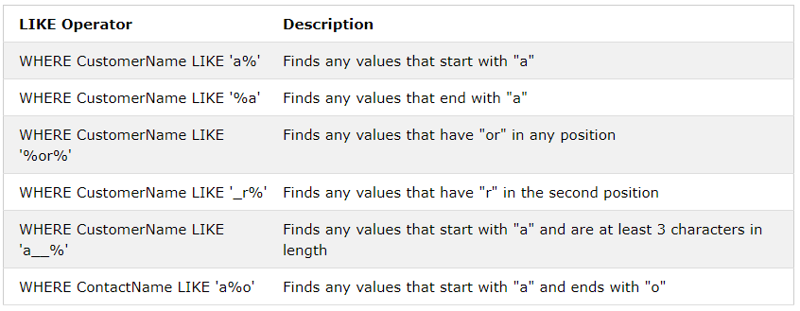
Different LIKE operators

Slide 22
SQL IN Operator
The IN operator allows you to specify multiple values in a WHERE clause. The IN operator is a shorthand for multiple OR conditions.
Syntax: SELECT column_name(s) FROM table_name WHERE column_name IN (value1, value2, ...);

Slide 23
SQL ORDER BY Keyword
The ORDER BY keyword is used to sort the result-set in ascending or descending order.
The ORDER BY keyword sorts the records in ascending order by default. To sort the records in descending order, use the DESC keyword.
Syntax: SELECT column1, column2, ... FROM table_name ORDER BY column1, column2, ... ASC|DESC;

Slide 24
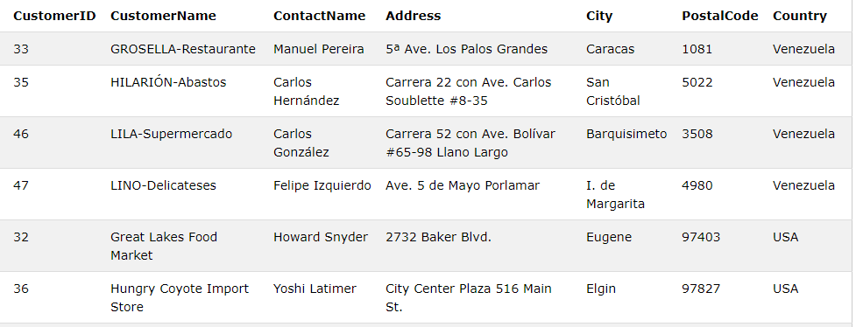
ORDER BY DESC Example
SELECT * FROM Customers ORDER BY Country DESC;

Slide 25
SQL GROUP BY Statement
The GROUP BY statement group rows that have the same values into summary rows, like "find the number of customers in each country".
The GROUP BY statement is often used with aggregate functions (COUNT, MAX, MIN, SUM, AVG) to group the result-set by one or more columns.

Slide 26
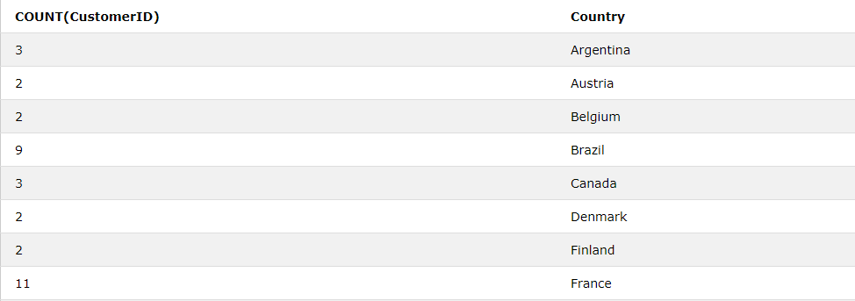
SQL GROUP BY Examples
SELECT COUNT(CustomerID), Country FROM Customers GROUP BY Country;

Slide 27
The SQL HAVING Clause
The HAVING clause was added to SQL because the WHERE keyword could not be used with aggregate functions.
Syntax: SELECT column_name(s) FROM table_name WHERE condition GROUP BY column_name(s) HAVING condition ORDER BY column_name(s);

Slide 28
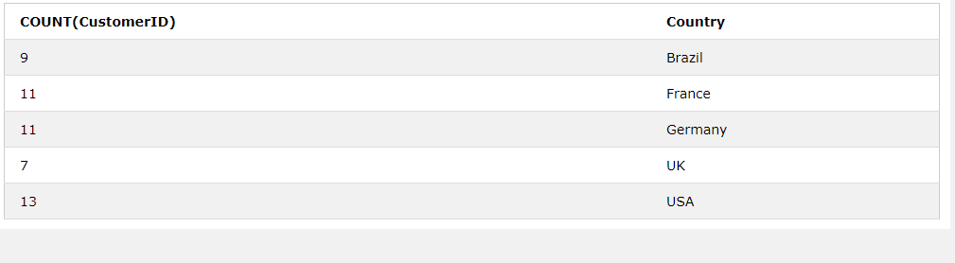
SQL HAVING Examples
SELECT COUNT(CustomerID), Country FROM Customers GROUP BY Country HAVING COUNT(CustomerID) > 5;

Slide 29
SQL TOP and LIMIT Clause
The SELECT TOP clause is used to specify the number of records to return.
Example: SELECT TOP 3 * FROM Customers;
The following SQL statement shows the equivalent example using the LIMIT clause:
Example: SELECT * FROM Customers LIMIT 3;

Slide 30
SQL CREATE TABLE Statement
The CREATE TABLE statement is used to create a new table in a database.
Syntax :
CREATE TABLE table_name ( column1 datatype, column2 datatype, column3 datatype, .... );

Slide 31
SQL DROP TABLE Statement
The DROP TABLE statement is used to drop an existing table in a database.
Syntax: DROP TABLE table_name;

Slide 32
SQL TRUNCATE TABLE
The TRUNCATE TABLE statement is used to delete the data inside a table, but not the table itself.
Syntax: TRUNCATE TABLE table_name;

Slide 33
SQL CREATE INDEX Statement
Indexes are used to retrieve data from the database very fast. The users cannot see the indexes, they are just used to speed up searches/queries.

Slide 34
SQL CREATE INDEX Statement
CREATE INDEX Syntax: CREATE INDEX index_name ON table_name (column1, column2, ...);
CREATE UNIQUE INDEX Syntax: CREATE UNIQUE INDEX index_name ON table_name (column1, column2, ...);

Slide 35
SQL ALTER TABLE Statement
The ALTER TABLE statement is used to add, delete, or modify columns in an existing table.
The ALTER TABLE statement is also used to add and drop various constraints on an existing table.

Slide 36
ALTER TABLE - ADD Column
syntax: ALTER TABLE table_name ADD column_name datatype;
Example: ALTER TABLE Customers ADD Email varchar(255);

Slide 37
ALTER TABLE - DROP COLUMN
Syntax: ALTER TABLE table_name DROP COLUMN column_name;
Example: ALTER TABLE Customers DROP COLUMN Email;

Slide 38
ALTER TABLE - ALTER/MODIFY COLUMN
Syntax: ALTER TABLE table_name ALTER COLUMN column_name datatype;
Example: ALTER TABLE Persons ALTER COLUMN DateOfBirth year;

Slide 39
SQL INSERT INTO Statement
Statement: INSERT INTO table_name (column1, column2, column3, ...) VALUES (value1, value2, value3, ...);
If adding values for all the columns of the table, do not need to specify the column names in the SQL query.
Example: INSERT INTO table_name VALUES (value1, value2, value3, ...);

Slide 40
SQL UPDATE Statement
Syntax: UPDATE table_name SET column1 = value1, column2 = value2, ... WHERE condition;
Example: UPDATE Customers SET ContactName = 'Alfred Schmidt', City= 'Frankfurt' WHERE CustomerID = 1;

Slide 41
SQL DELETE Statement
Syntax: DELETE FROM table_name WHERE condition;
Example: DELETE FROM Customers WHERE
CustomerName='Alfreds Futterkiste';

Slide 42
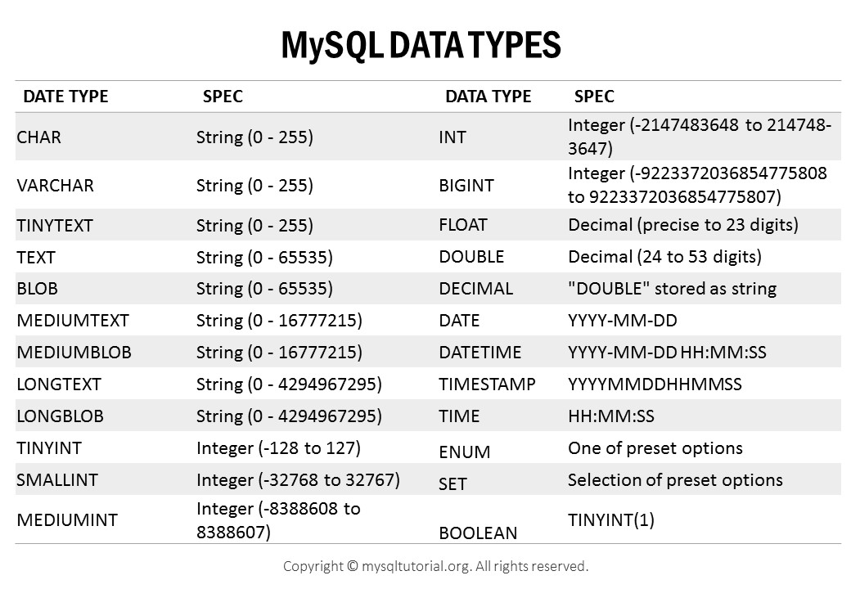
SQL Data Types

Slide 43
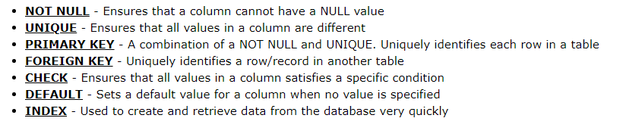
SQL Constraints
SQL constraints are used to specify rules for data in a table.

Slide 44
UNIQUE Constraint Example
CREATE TABLE Persons ( ID int NOT NULL UNIQUE, LastName varchar(255) NOT NULL, FirstName varchar(255), Age int );

Slide 45
NOT NULL constraint Example
CREATE TABLE Persons ( ID int NOT NULL, LastName varchar(255) NOT NULL, FirstName varchar(255) NOT NULL, Age int );

Slide 46
PRIMARY KEY Constraint Example
CREATE TABLE Persons ( ID int NOT NULL, LastName varchar(255) NOT NULL, FirstName varchar(255), Age int, PRIMARY KEY (ID) );

Slide 47
FOREIGN KEY Constraint Example
CREATE TABLE Orders ( OrderID int NOT NULL, OrderNumber int NOT NULL, PersonID int, PRIMARY KEY (OrderID), FOREIGN KEY (PersonID) REFERENCES Persons(PersonID) );

Slide 48
CHECK Constraint Example
CREATE TABLE Persons ( ID int NOT NULL, LastName varchar(255) NOT NULL, FirstName varchar(255), Age int, CHECK (Age>=18) );

Slide 49
DEFAULT Constraint Example
CREATE TABLE Persons ( ID int NOT NULL, LastName varchar(255) NOT NULL, FirstName varchar(255), Age int, City varchar(255) DEFAULT 'Sandnes' );

Slide 50
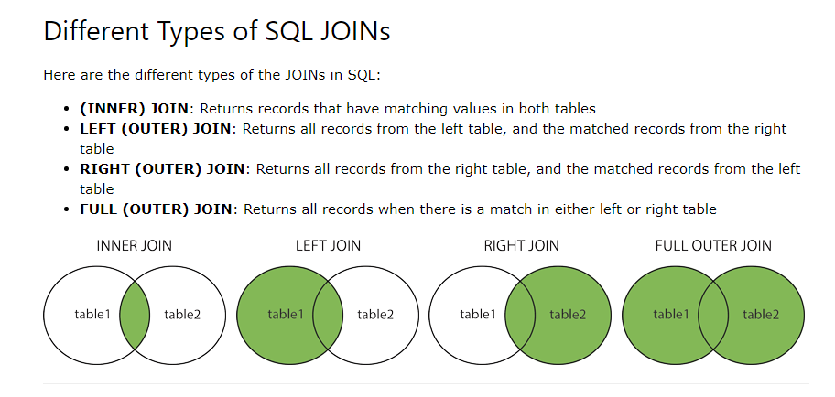
SQL JOIN

Slide 51
SQL INNER JOIN
Syntax:
SELECT column_name(s) FROM table1 INNER JOIN table2 ON table1.column_name = table2.column_name;
Example:
SELECT Orders.OrderID, Customers.CustomerName FROM Orders INNER JOIN Customers ON Orders.CustomerID = Customers.CustomerID;

Slide 52
SQL LEFT JOIN
Syntax : SELECT column_name(s) FROM table1 LEFT JOIN table2 ON table1.column_name = table2.column_name;
Example: SELECT Customers.CustomerName, Orders.OrderID FROM Customers LEFT JOIN Orders ON Customers.CustomerID = Orders.CustomerID ORDER BY Customers.CustomerName;

Slide 53
SQL RIGHT JOIN
Syntax: SELECT column_name(s) FROM table1 RIGHT JOIN table2 ON table1.column_name = table2.column_name;
Example: SELECT Orders.OrderID, Employees.LastName, Employees.FirstName FROM Orders RIGHT JOIN Employees ON Orders.EmployeeID = Employees.EmployeeID ORDER BY Orders.OrderID;

Slide 54
SQL FULL OUTER JOIN
Syntax: SELECT column_name(s) FROM table1 FULL OUTER JOIN table2 ON table1.column_name = table2.column_name WHERE condition;
Example: SELECT Customers.CustomerName, Orders.OrderID FROM Customers FULL OUTER JOIN Orders ON Customers.CustomerID=Orders.CustomerID ORDER BY Customers.CustomerName;

Slide 55
SQL UNION Operator
The UNION operator is used to combine the result-set of two or more SELECT statements.
Syntax: SELECT column_name(s) FROM table1 UNION ALL SELECT column_name(s) FROM table2;
Example: SELECT City FROM Customers UNION SELECT City FROM Suppliers ORDER BY City;

Slide 56
SQL Views
In SQL, a view is a virtual table based on the result-set of an SQL statement.
A view contains rows and columns, just like a real table. The fields in a view are fields from one or more real tables in the database.

Slide 57
SQL Views
Syntax: CREATE VIEW view_name AS SELECT column1, column2, ... FROM table_name WHERE condition;
Example: CREATE VIEW [Brazil Customers] AS SELECT CustomerName, ContactName FROM Customers WHERE Country = "Brazil";
Example: SELECT * FROM [Brazil Customers];

Slide 58
SQL CREATE OR REPLACE, DROP VIEW
Example: CREATE OR REPLACE VIEW [Brazil Customers] AS SELECT CustomerName, ContactName, City FROM Customers WHERE Country = "Brazil";
SQL DROP VIEW Syntax: DROP VIEW view_name;

Slide 59
The COMMIT Command
The COMMIT command is the transactional command used to save changes invoked by a transaction to the database.
Example:
SQL> DELETE FROM CUSTOMERS
WHERE AGE = 25;
SQL> COMMIT;

Slide 60
The ROLLBACK Command
The ROLLBACK command is the transactional command used to undo transactions that have not already been saved to the database. This command can only be used to undo transactions since the last COMMIT or ROLLBACK command was issued.
Example:
SQL> DELETE FROM CUSTOMERS
WHERE AGE = 25;
SQL> ROLLBACK;

Slide 61
SQL BACKUP DATABASE for SQL Server
Syntax: BACKUP DATABASE databasename
TO DISK = 'filepath’;
A differential back up only backs up the parts of the database that have changed since the last full database backup.
Syntax: BACKUP DATABASE databasename TO DISK = 'filepath' WITH DIFFERENTIAL;

Slide 62
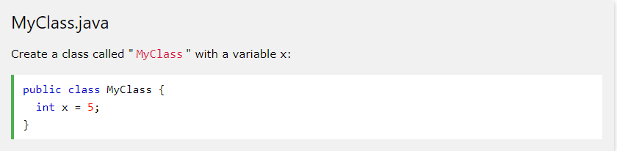
Object Oriented Programming: Class
A class is simply a representation of a type of object. It is the blueprint/plan/template that describes the details of an object.

Slide 63
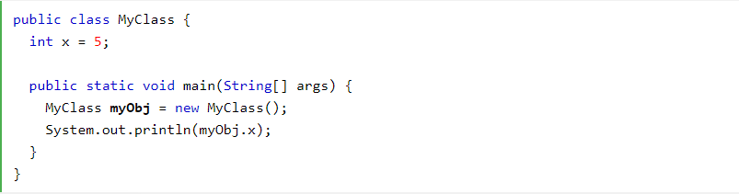
Object Oriented Programming: Object
An object is an instance of a class. It has its own state, behavior, and identity.

Slide 64
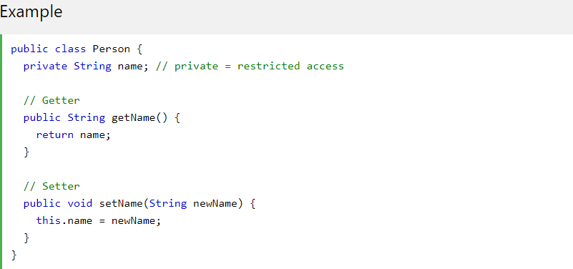
Object Oriented Programming: Encapsulation
Encapsulation is a process of combining data members and functions in a single unit called class. This is to prevent the access to the data directly, the access to them is provided through the functions of the class.

Slide 65
Object Oriented Programming: Abstraction
Abstraction is a good feature of OOPS, and it shows only the necessary details to the client of an object. Means, it shows only required details for an object, not the inner constructors, of an object.
Abstract class: is a restricted class that cannot be used to create objects (to access it, it must be inherited from another class).
Abstract method: can only be used in an abstract class, and it does not have a body. The body is provided by the subclass (inherited from).

Slide 66
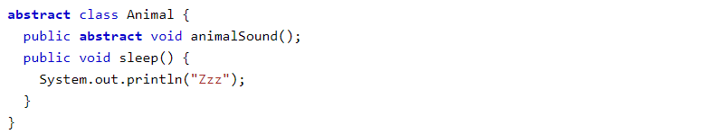
Example: Abstraction
From the example above, it is not possible to create an object of the Animal class:

Slide 67
Object Oriented Programming: Inheritance
It is possible to inherit attributes and methods from one class to another. The "inheritance concept" into two categories:
subclass (child) - the class that inherits from another class.
superclass (parent) - the class being inherited from.

Slide 68
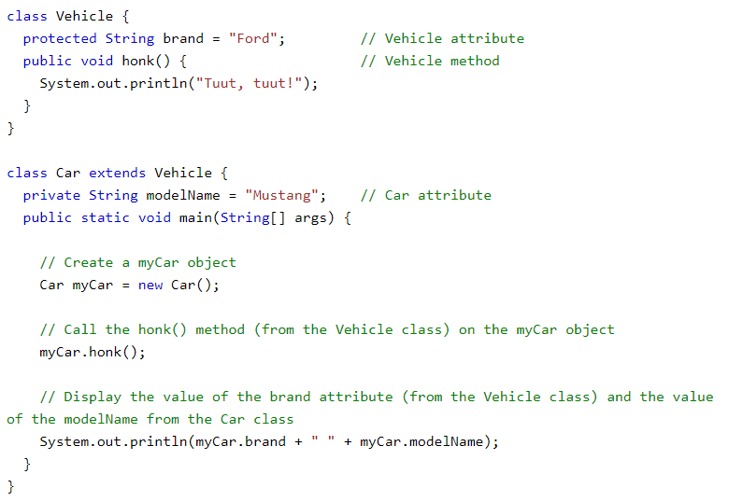
Inheritance Example (Java)

Slide 69
Object Oriented Programming: Polymorphism
Polymorphism is nothing but assigning behavior or value in a subclass to something that was already declared in the main class. Simply, polymorphism takes more than one form.

Slide 70
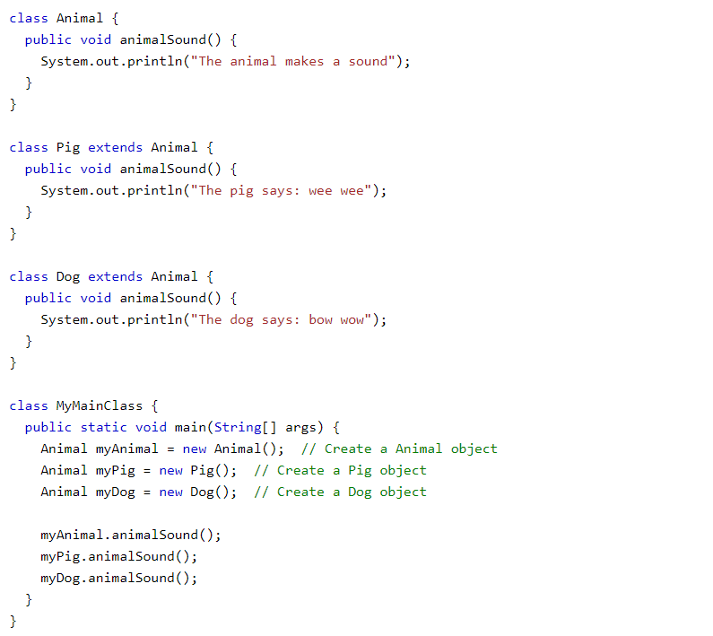
Polymorphism Example (Java)

Slide 71
Clean Code
Clean code is subjective and every developer has a personal take on it. There are some ideas that are considered best practice and what constitutes as clean code within the industry and community, but there is no definitive distinction. And I don’t think there ever will be.

Slide 72
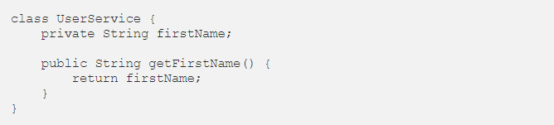
Clean Code: Naming Convention
All variables, methods and classes should use CamelCase style. The only difference: a first letter of class should be capital:

Slide 73

Clean Code: Naming Convention
Constants should use all capital letters divided with underscore:
Try to avoid special characters and numbers:

Slide 74
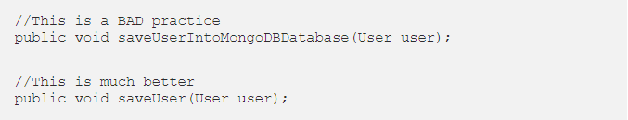
Clean Code: Naming Convention
Don’t use too much words in the variable/method name. It should be as simple as possible, but also informative.
Use verbs for function names and nouns for classes and attributes.

Slide 75
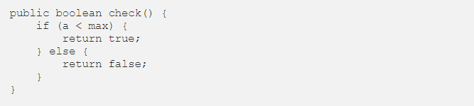
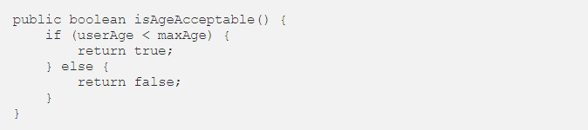
Clean Code: Naming Convention
Create variable with full name.
This code is totally unclear, so other developer will definitely not understand what this method does.
Written in a better way:

Slide 76
Clean Code: Variables/Methods
All variables in the class should be declared at the top of the class.
If variable is used only in one method then it would be better to declare it as a local variable of this method.
Methods should be declared in the same order as they are used (from top to bottom).
Also more important methods should be declared at the top of a class and minor methods at the end.

Slide 77
Clean Code: Single Responsibility
One method should be responsible only for one action. If your method does two or three different things at a time then you should consider splitting the functionality of this method into other methods.

Slide 78
Clean Code: Small Methods
There is no a standard pattern for method length among the developers. Someone can say that 10 lines is max size, someone can say 5, in some cases even 20 lines of code is okay. Just try to make methods as small as possible.

Slide 79
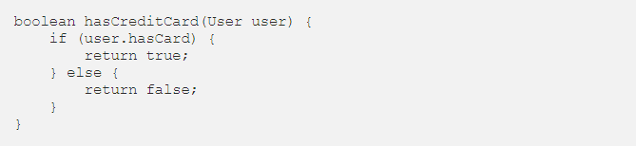

Clean Code: Minimize Code
Don’t write three lines of code if the same thing can be done with only one line.
Instead of using this
we can use this simplified code

Slide 80
Clean Code: Avoid code duplication
Try to avoid code duplication in project. If you cannot reuse a method in other place then probably this method is bad and should consider a better way to write this method. Methods must be as universal as possible. This will help team members to use method instead of writing own.

Slide 81
Clean Code: Comments
Try to explain what the code causes to happen.
Comments can be useful when placed in certain places.
Create method names and informative variables instead of explaining the code with comments.
Comments can be used to express the importance of certain points in the code.

Slide 82
Web server
A Web server is a program that uses HTTP (Hypertext Transfer Protocol) to serve the files that form Web pages to users, in response to their requests, which are forwarded by their computers' HTTP clients. Dedicated computers and appliances may be referred to as Web servers as well.

Slide 83
Microsoft IIS vs nginx vs Apache Tomcat
Internet Information Services (IIS) for Windows Server is a flexible, secure and manageable Web server for hosting anything on the Web.
nginx [engine x] is an HTTP and reverse proxy server, as well as a mail proxy server, written by Igor Sysoev.
Apache Tomcat powers numerous large-scale, mission-critical web applications across a diverse range of industries and organizations.

Slide 84
CSS
CSS helps you to keep the informational content of a document separate from the details of how to display it. The details of how to display the document are known as its style. You keep the style separate from the content so that you can:
Avoid duplication
Make maintenance easier
Use the same content with different styles for different purposes

